Slide 1







LIBRARY MANAGEMENT SYSTEM
Submitted by : Mehak negi
Sap Id : 590026050
Sumitted To : Mr Prashant trivedi

Slide 2



“A library needs a system that can store and manage all its books and user information in an easy and organized way. Doing everything manually—like keeping records of books, checking availability, or finding user details—takes a lot of time and may lead to mistakes.
This project, Library Management System, is designed to make these tasks simple and fast. It helps librarians and users manage books, borrow or return them, and view important information without confusion. The system reduces paperwork and makes the whole library process smoother and more efficient.”

Slide 3

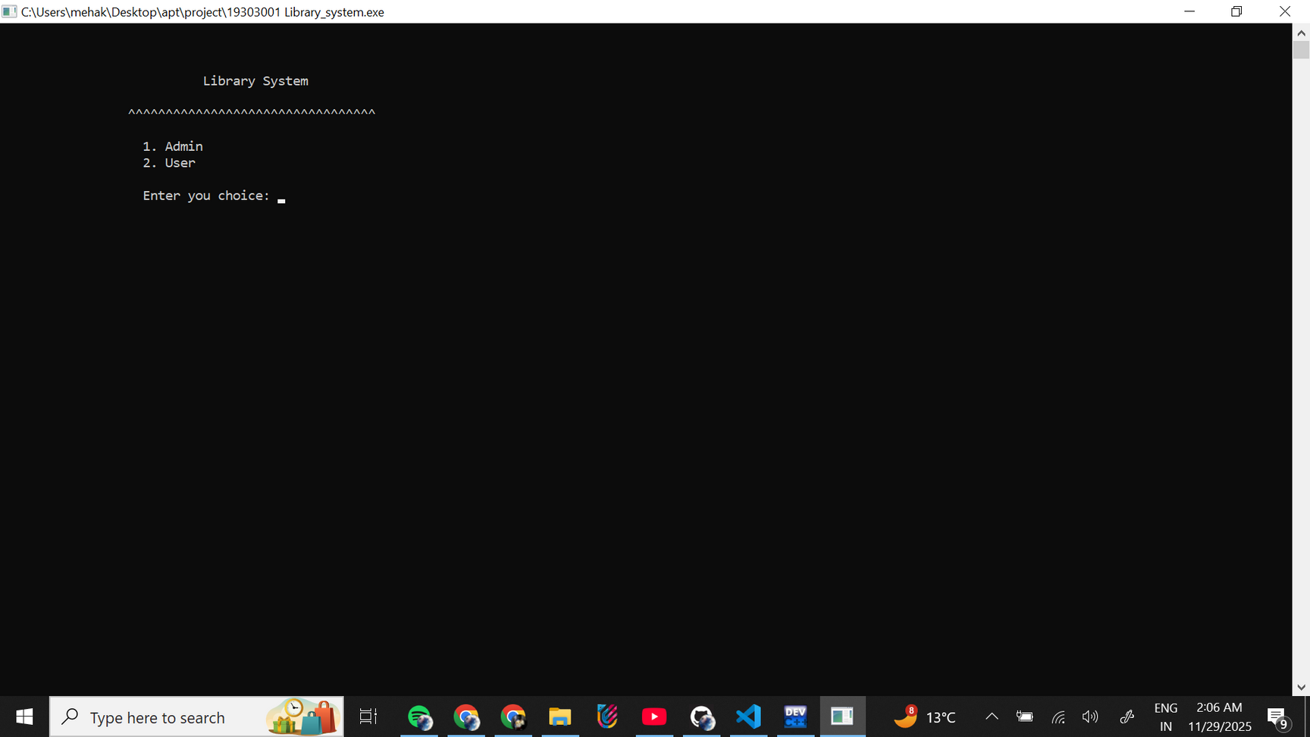

MAIN PROFILE

Slide 4

ADMIN

Slide 5

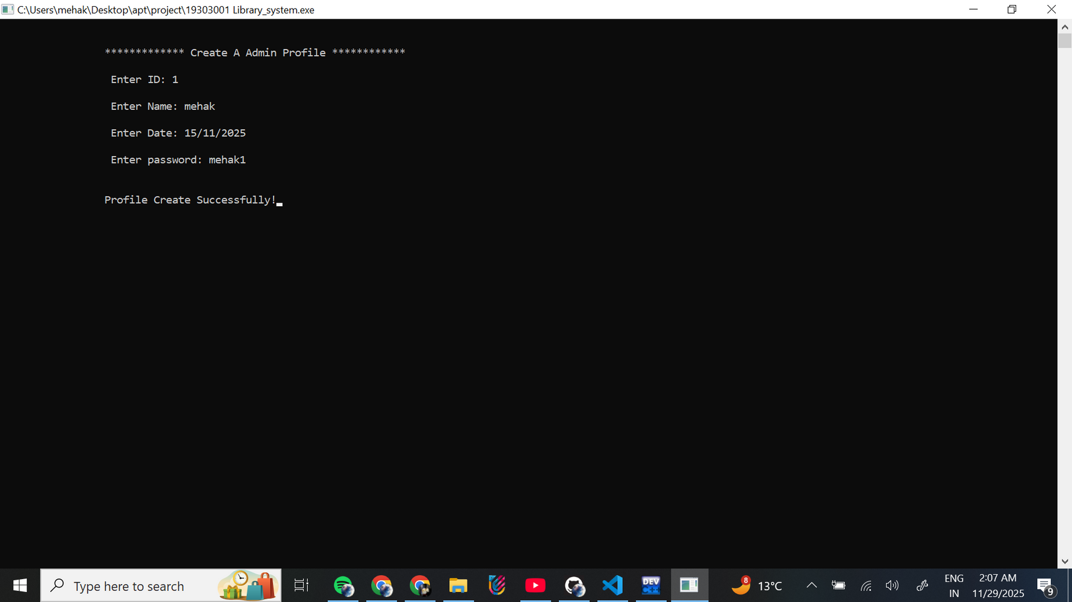

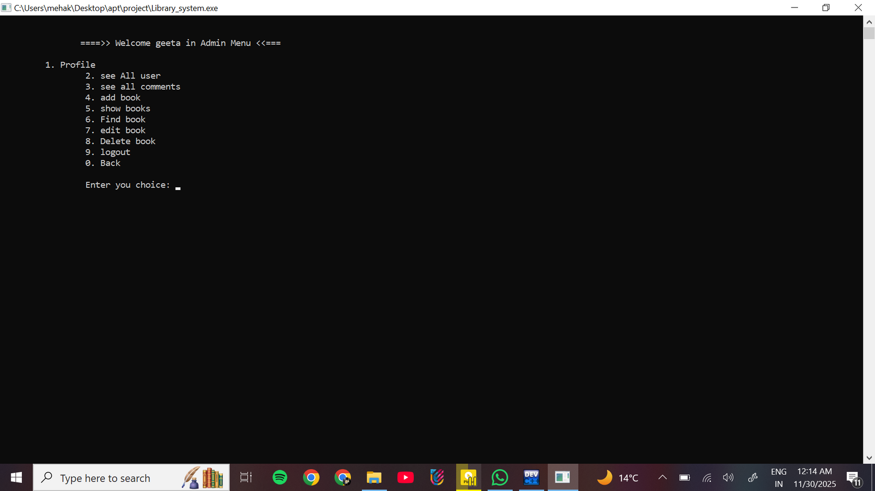
ADMIN OPTION
CREATE A ADMIN PROFILE
LOGIN
ADMIN MENU OPTION

Slide 6
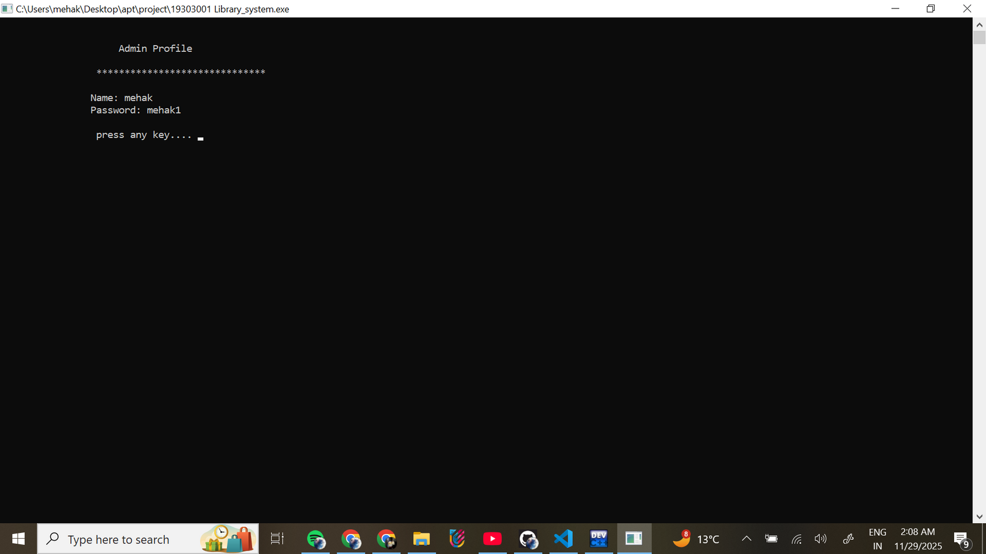
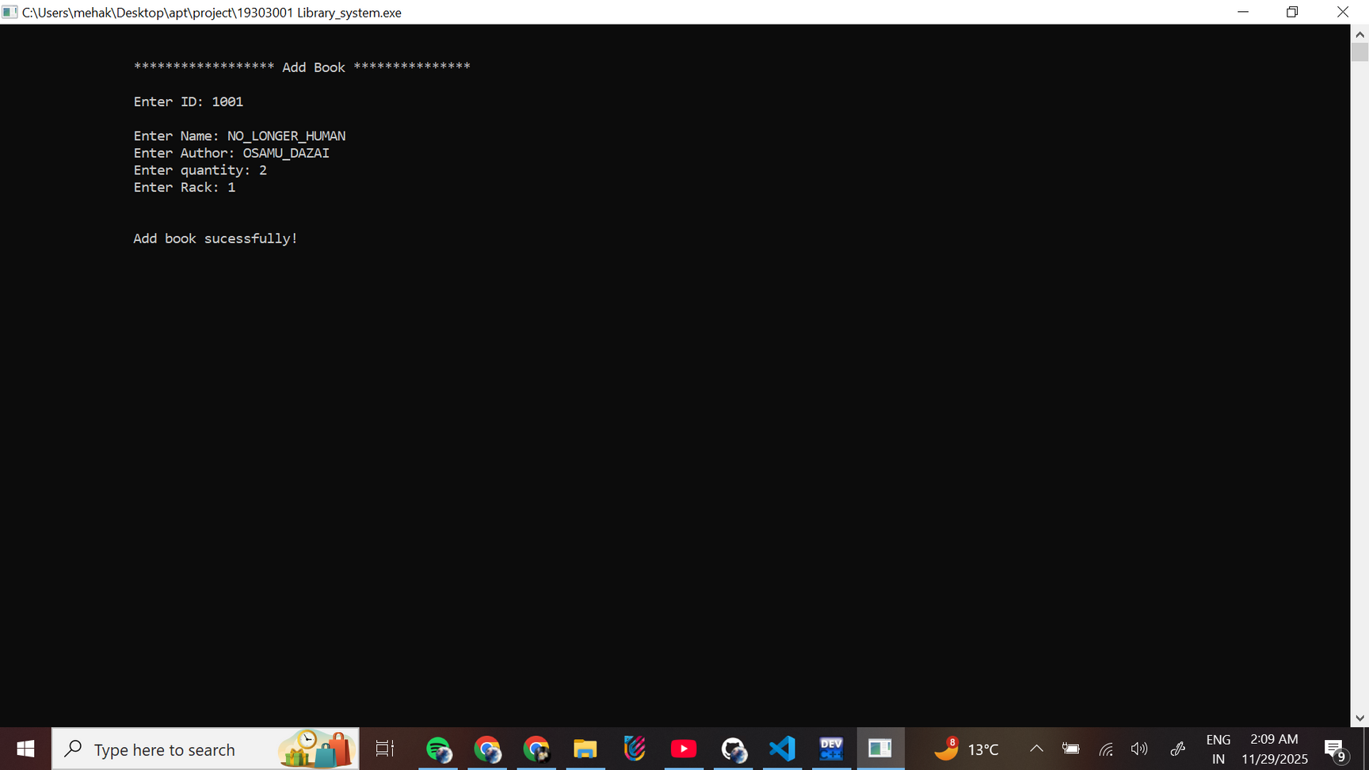
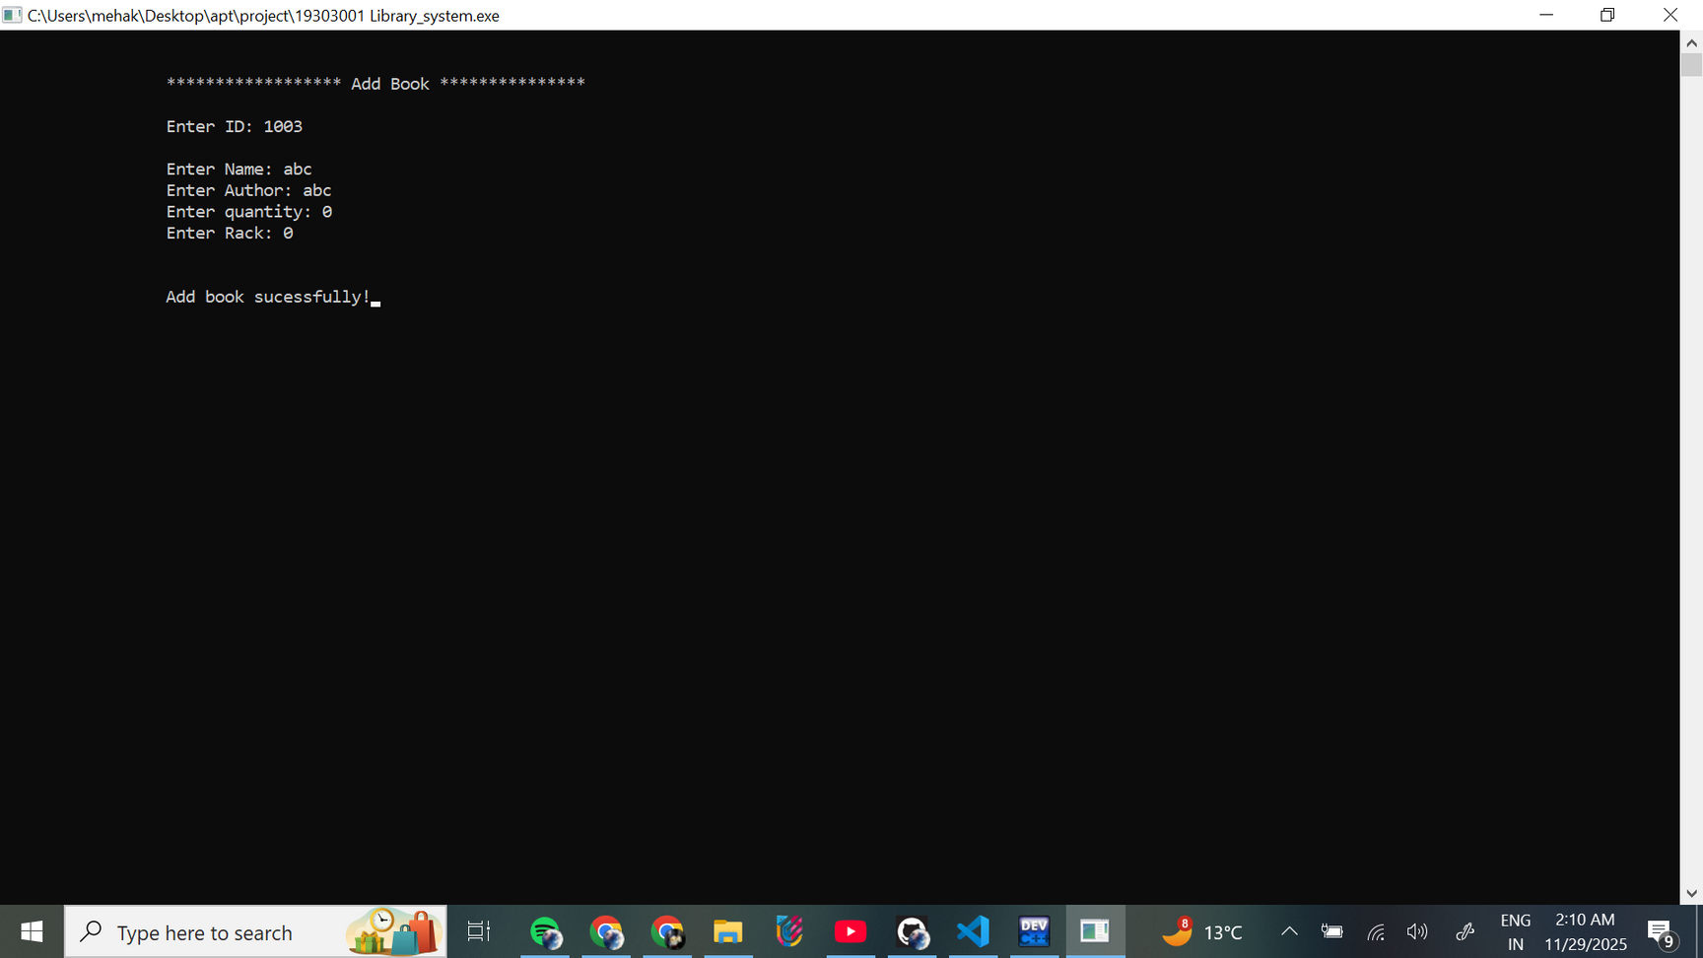
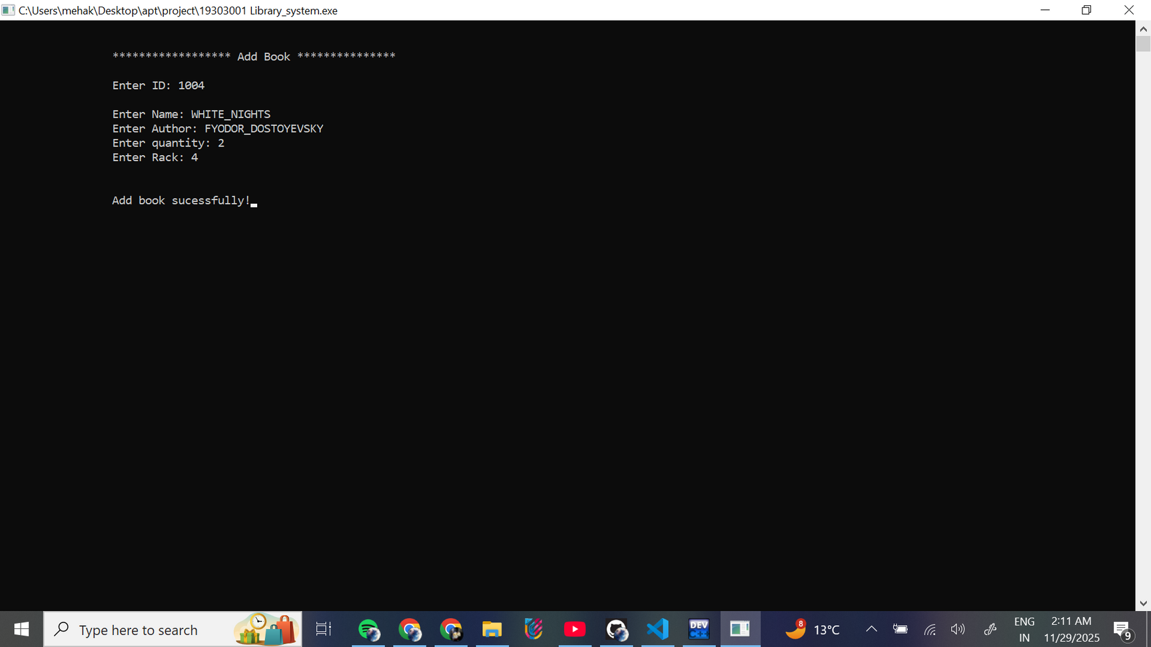
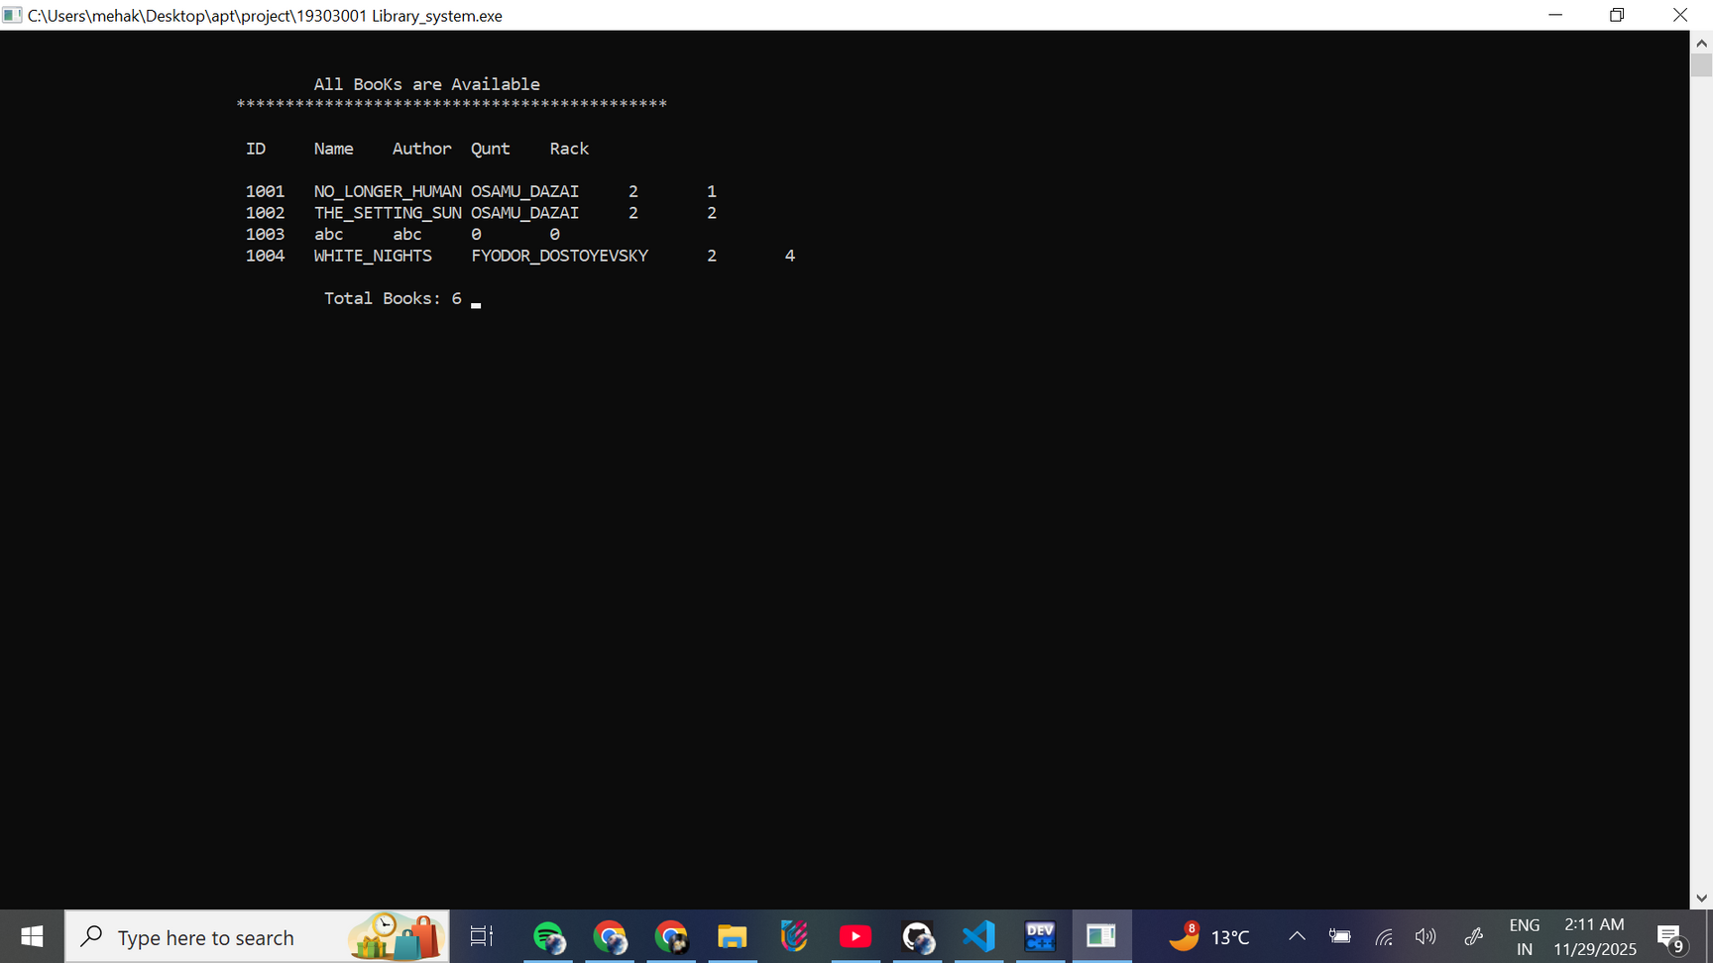
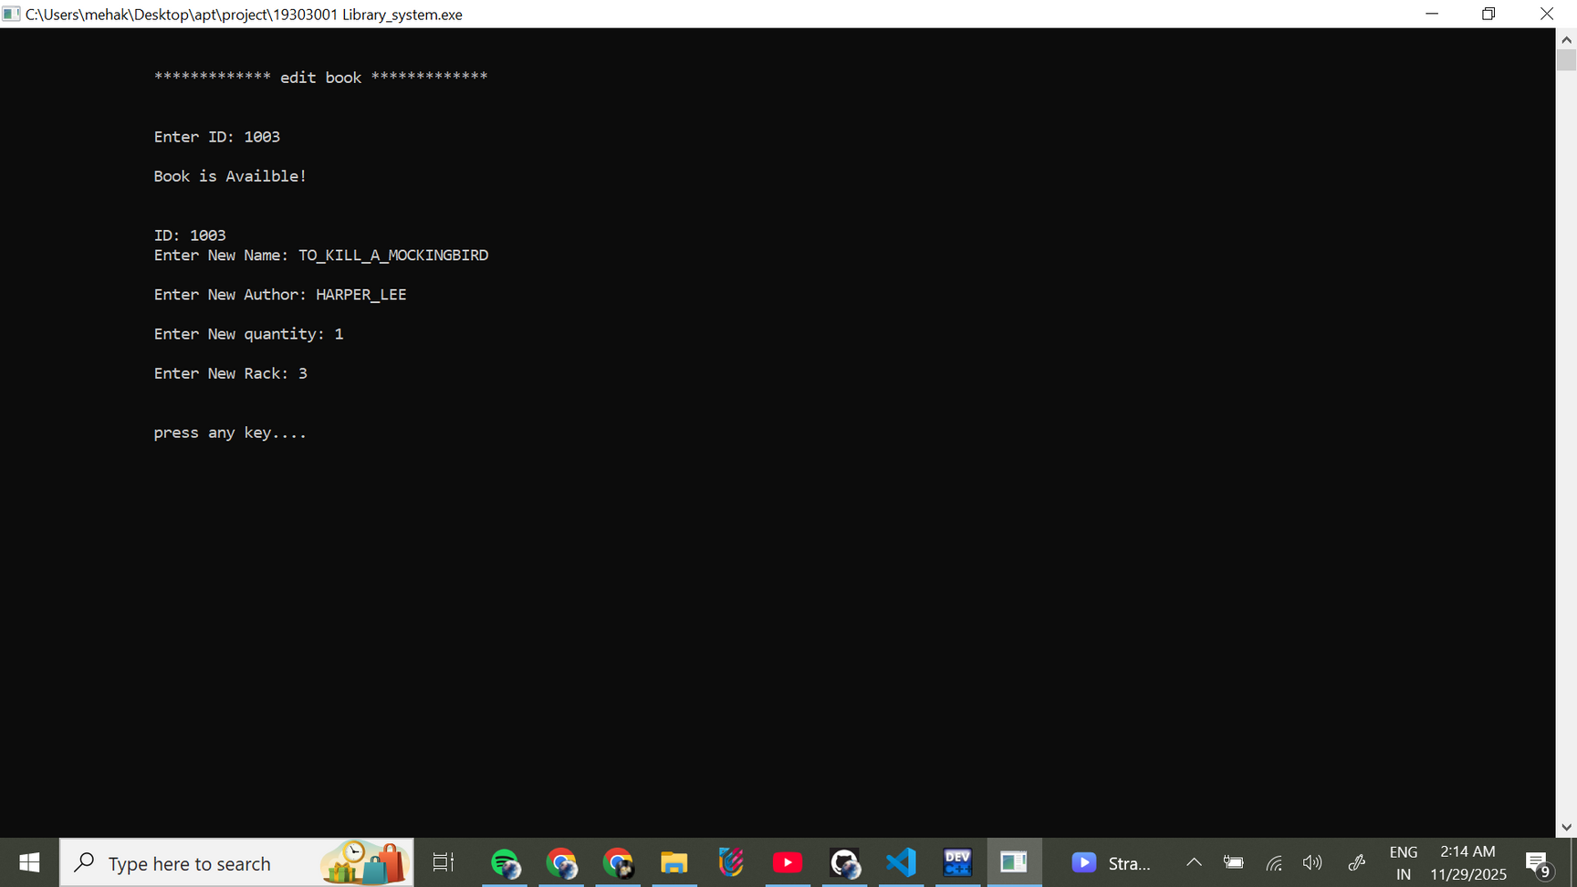
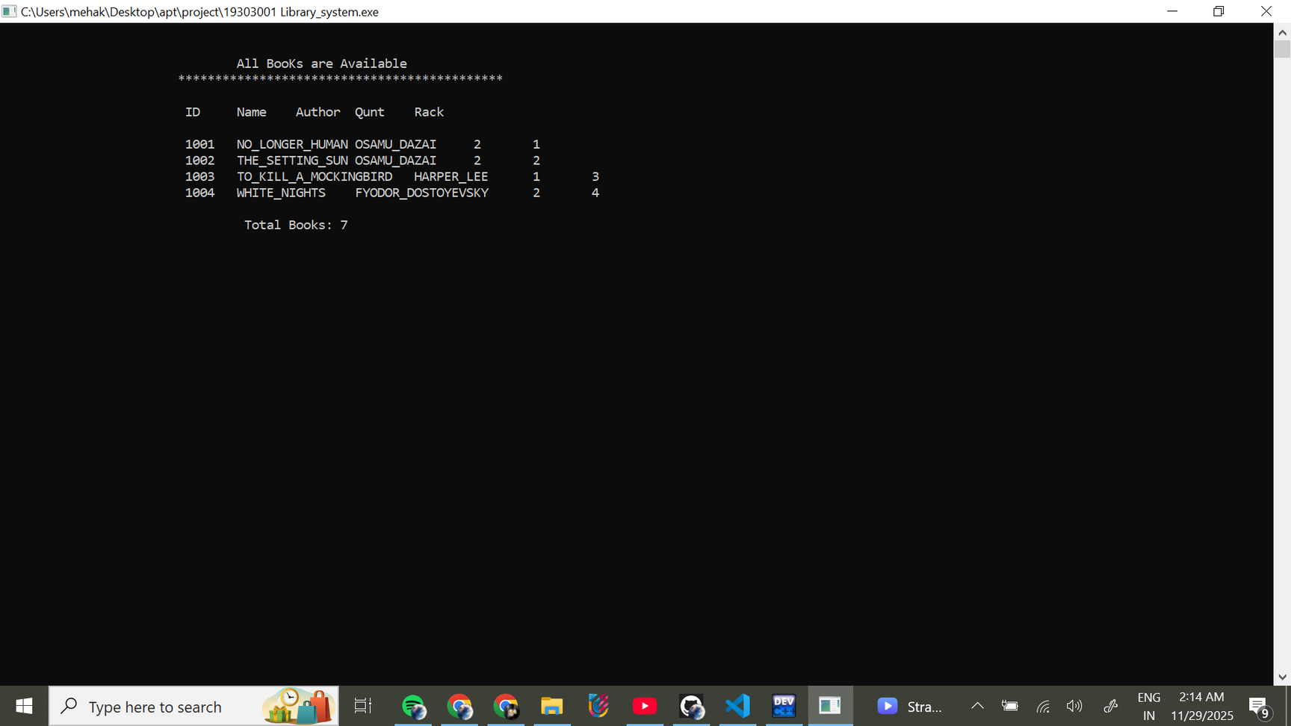
CHOICE 1
CHOICE 4
CHOICE 5
CHOICE 7

Slide 7
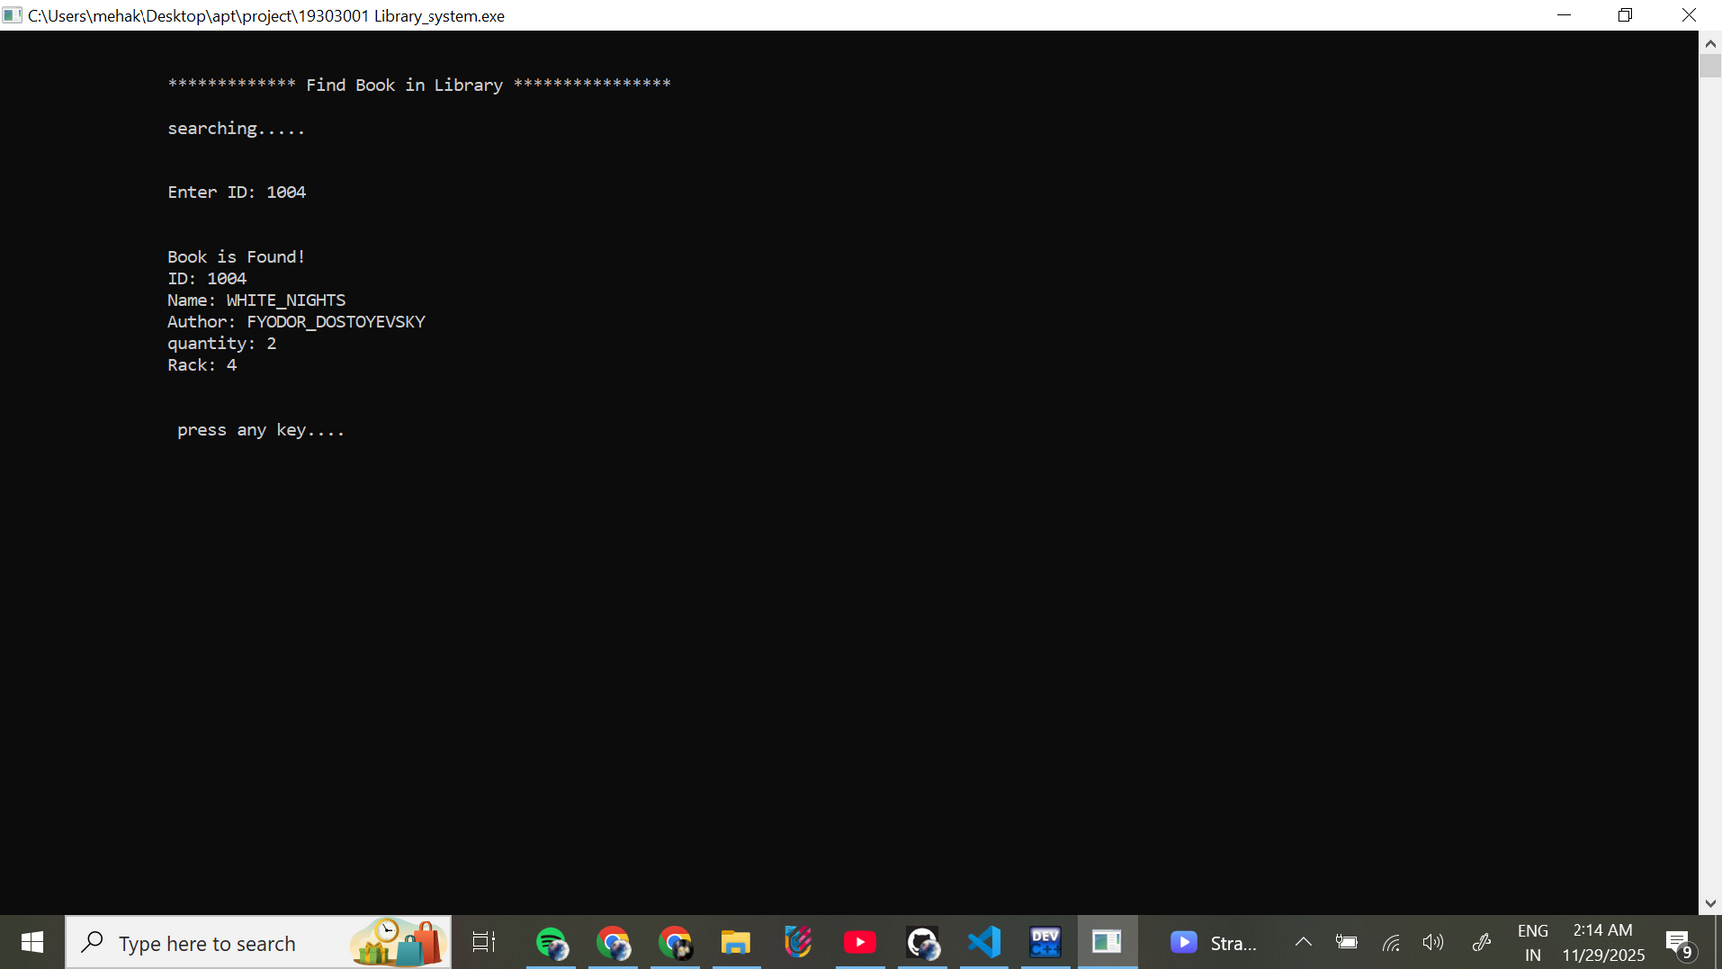
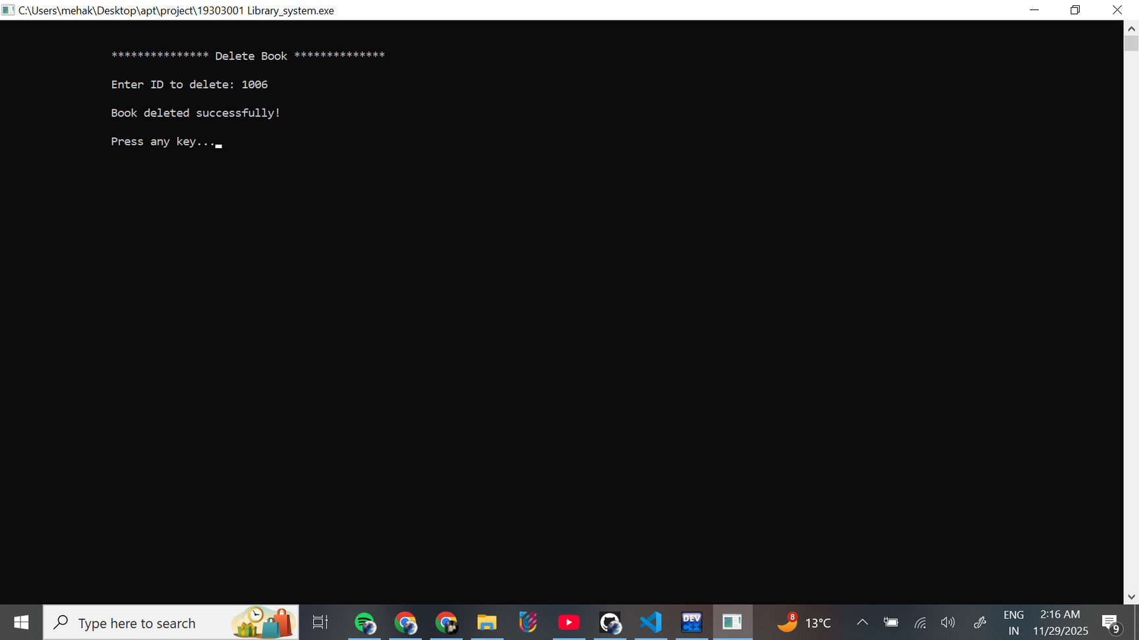
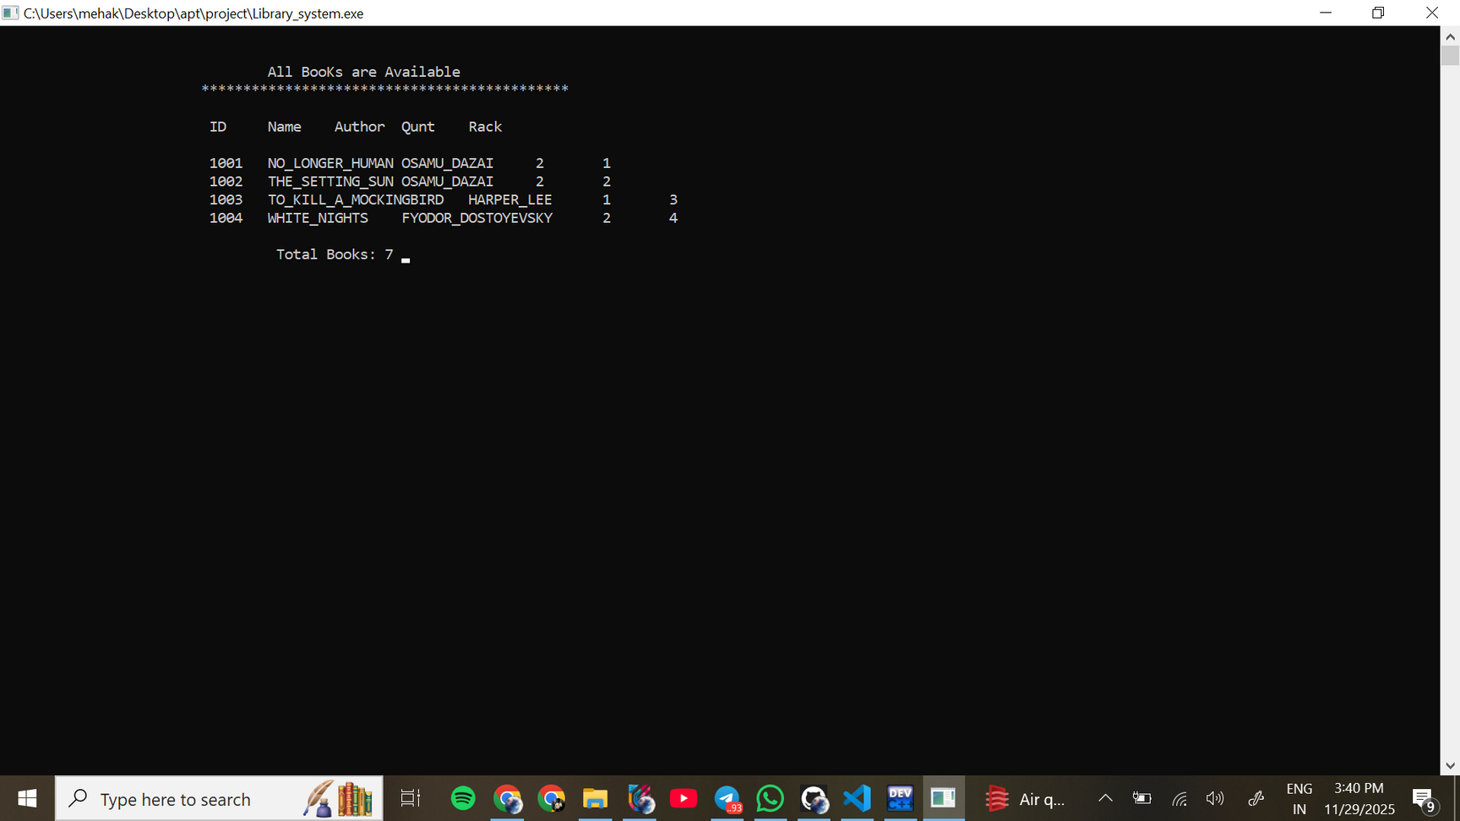
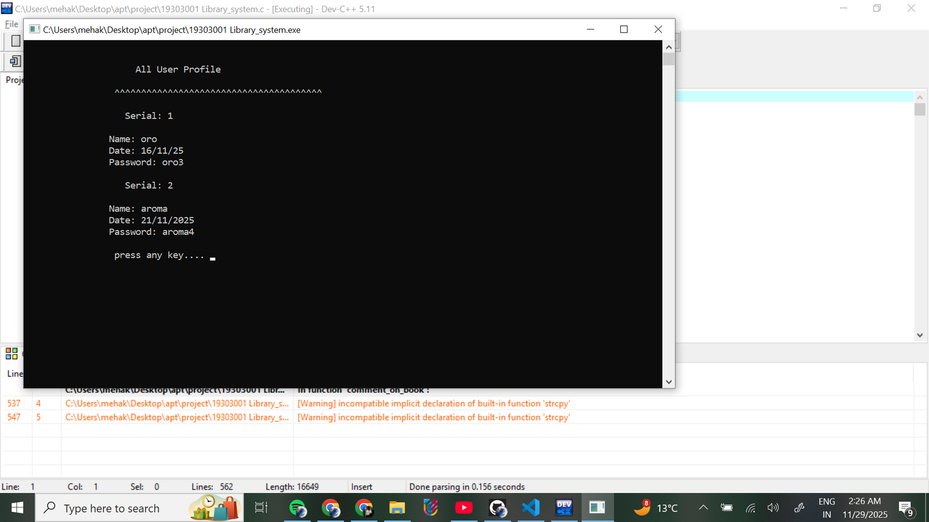
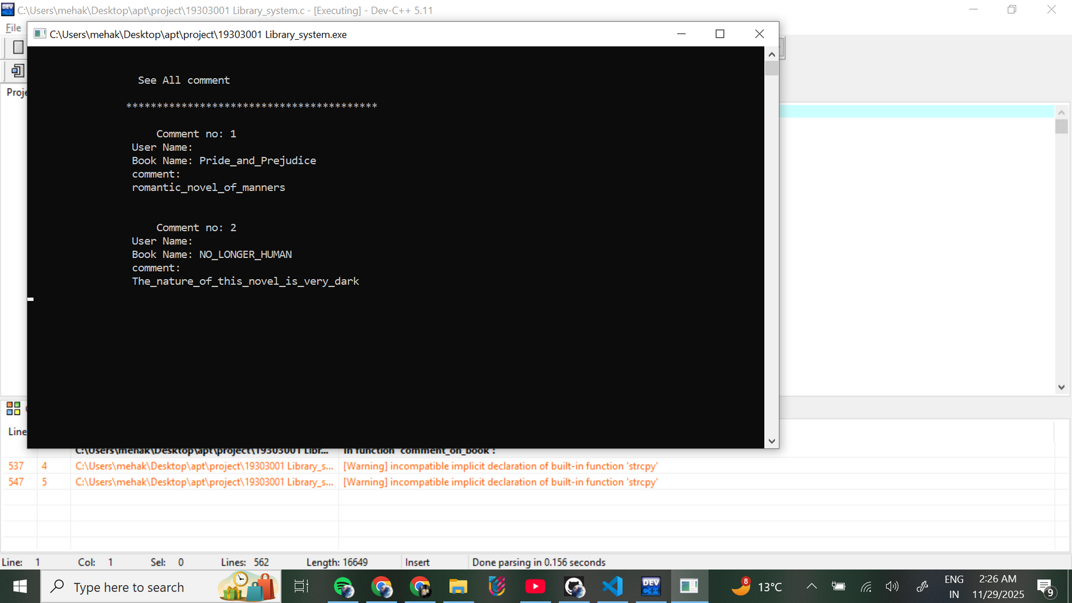
CHOICE 8
CHOICE 1
CHOICE 2

Slide 8
USER

Slide 9
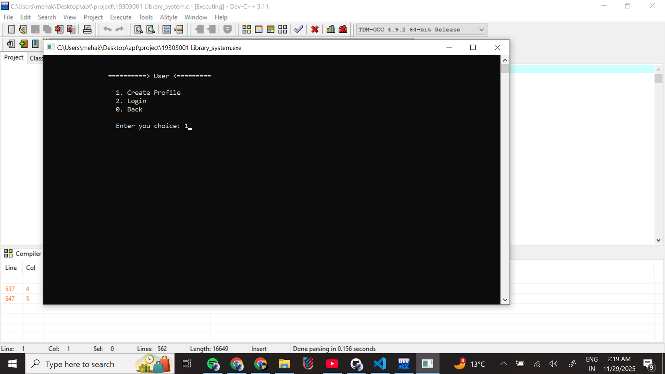
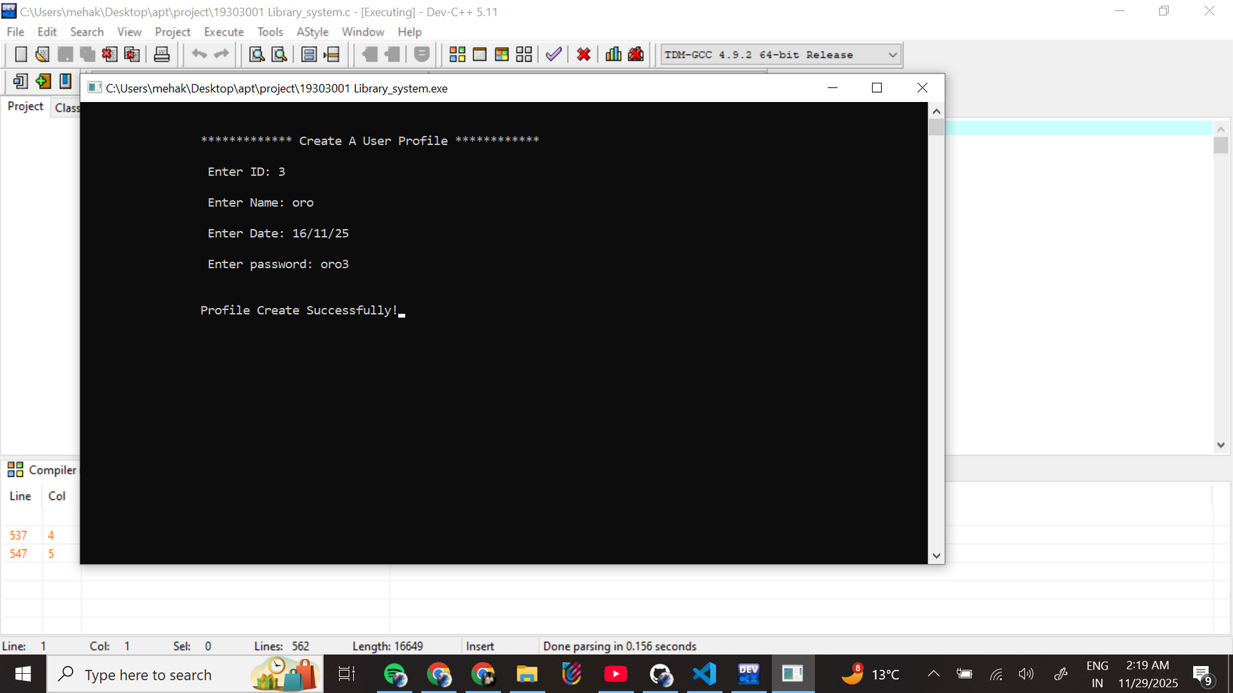
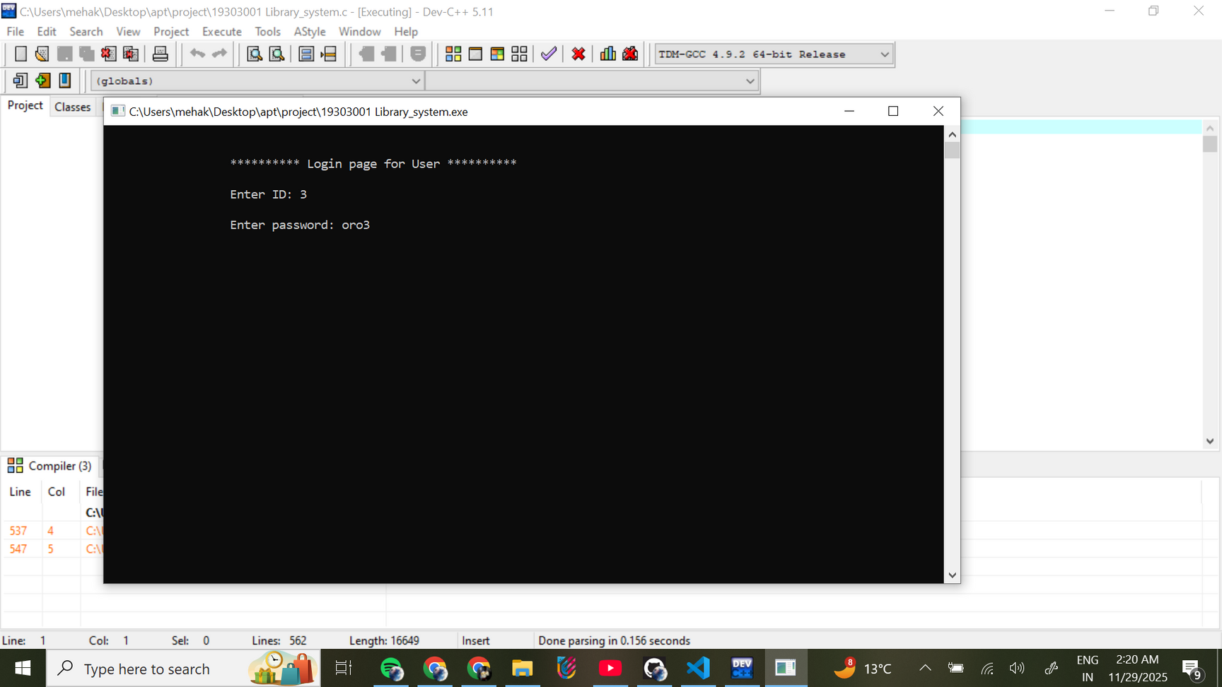
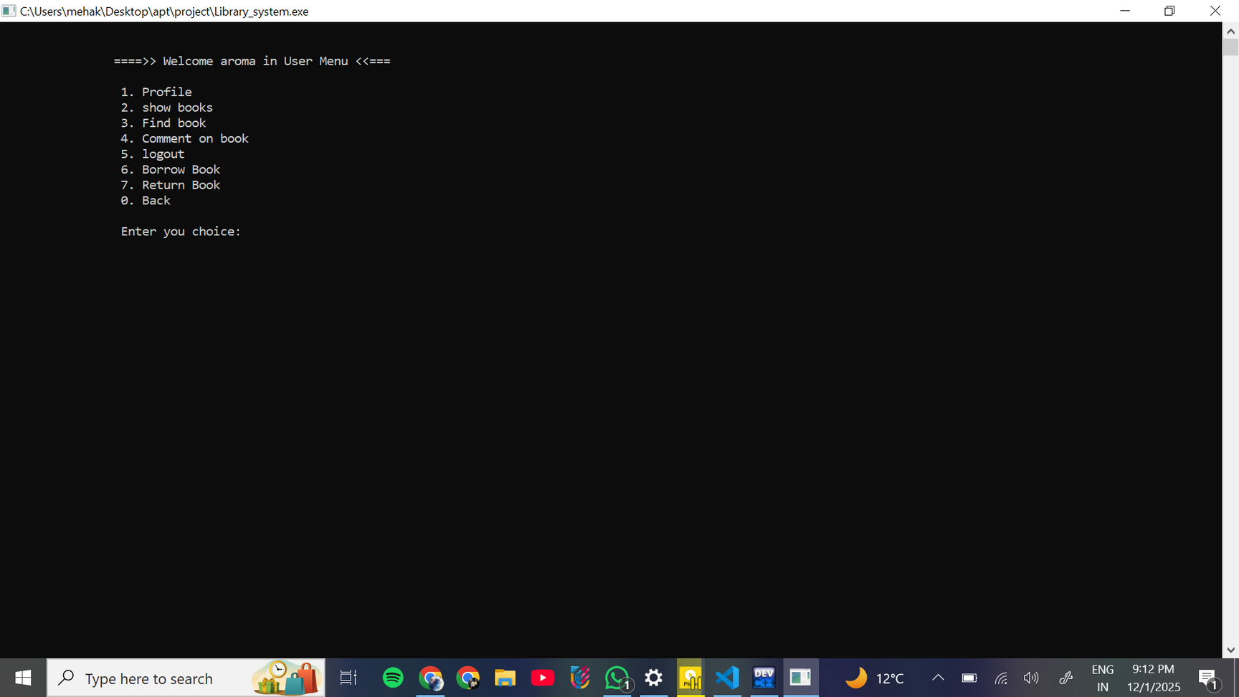
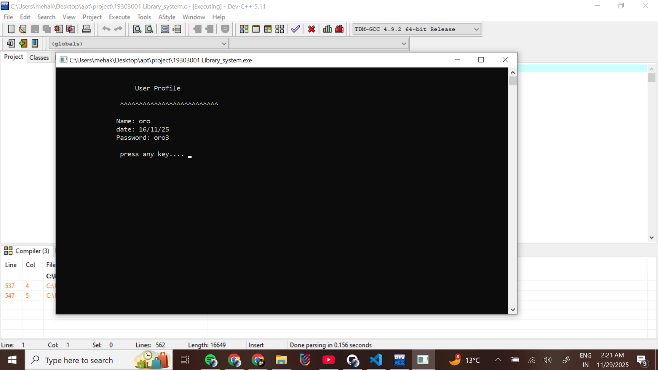
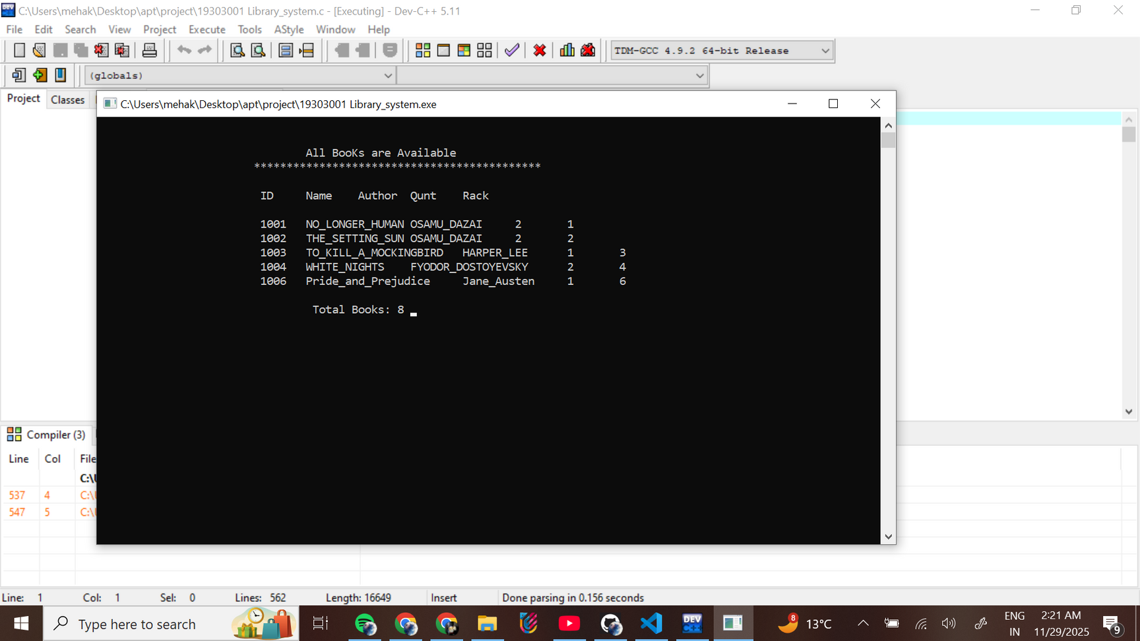

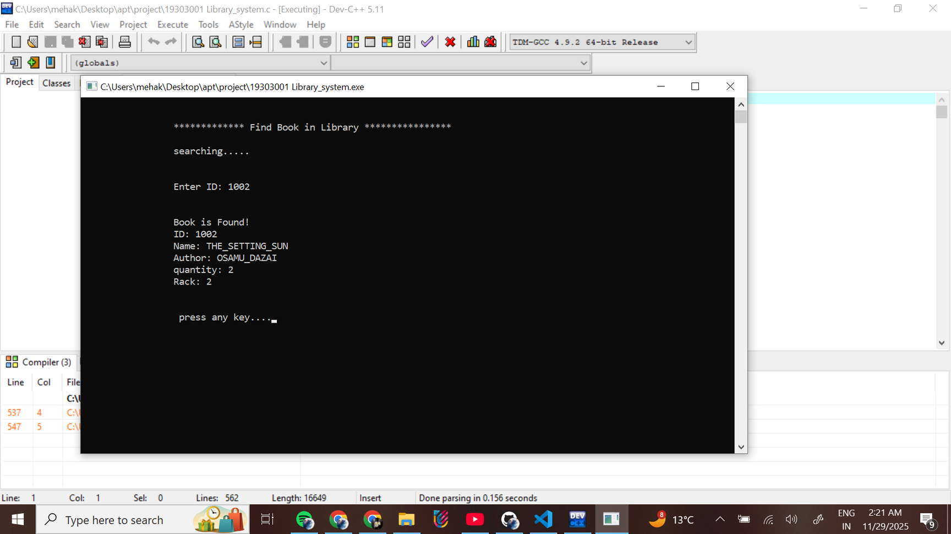
CREATE USER PROFILE
USER
LOGIN
USER MENU
CHOICE 2
CHOICE 1
CHOICE 3

Slide 10
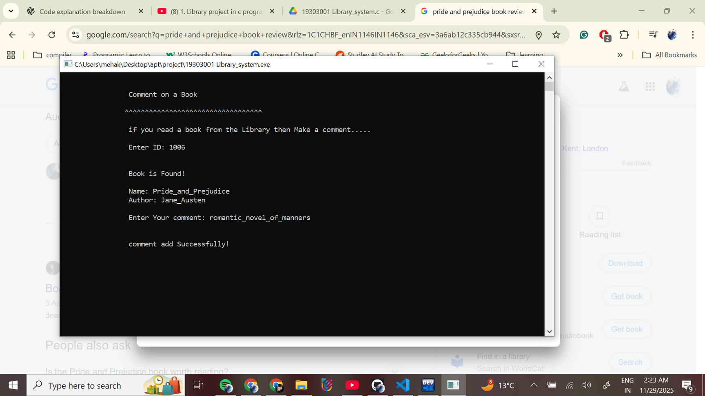
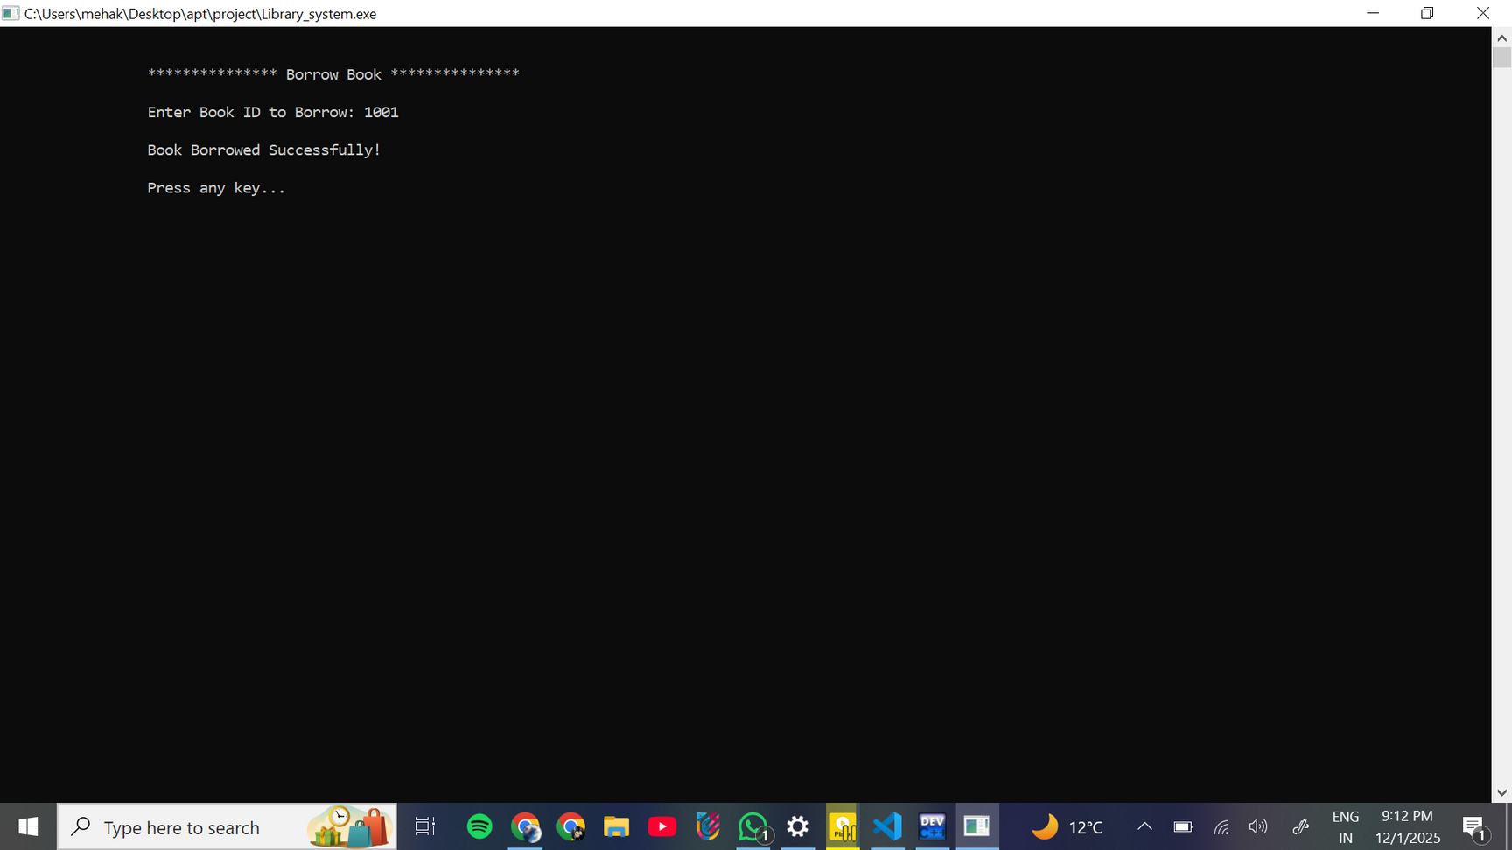
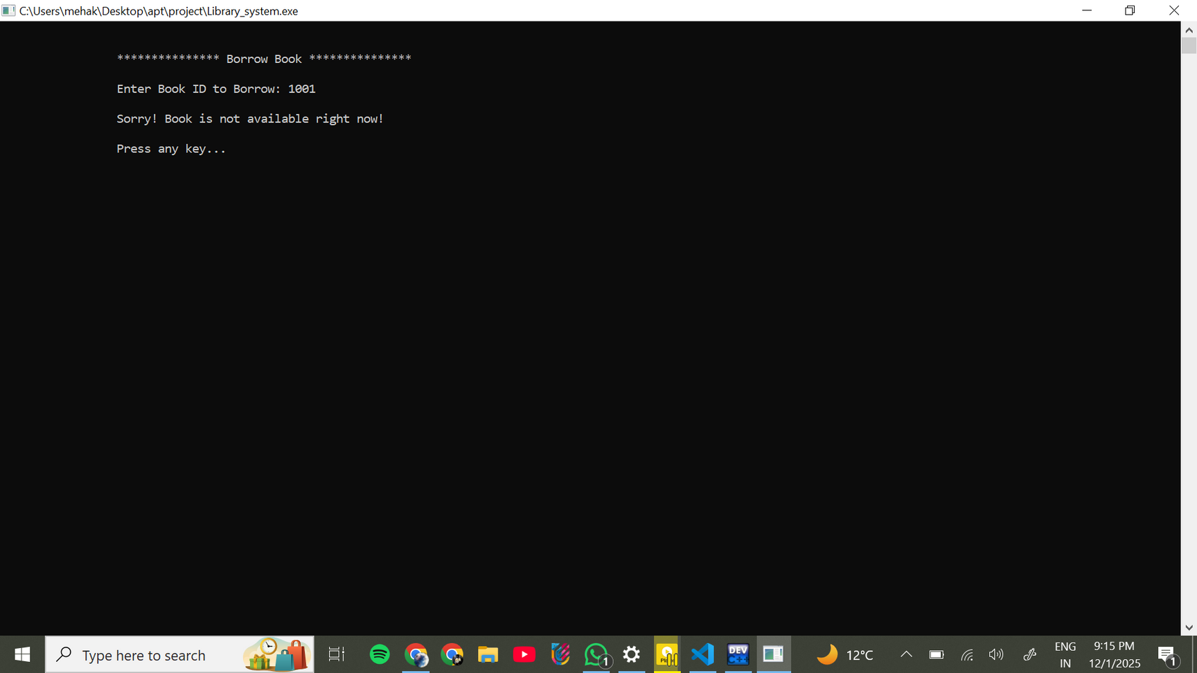

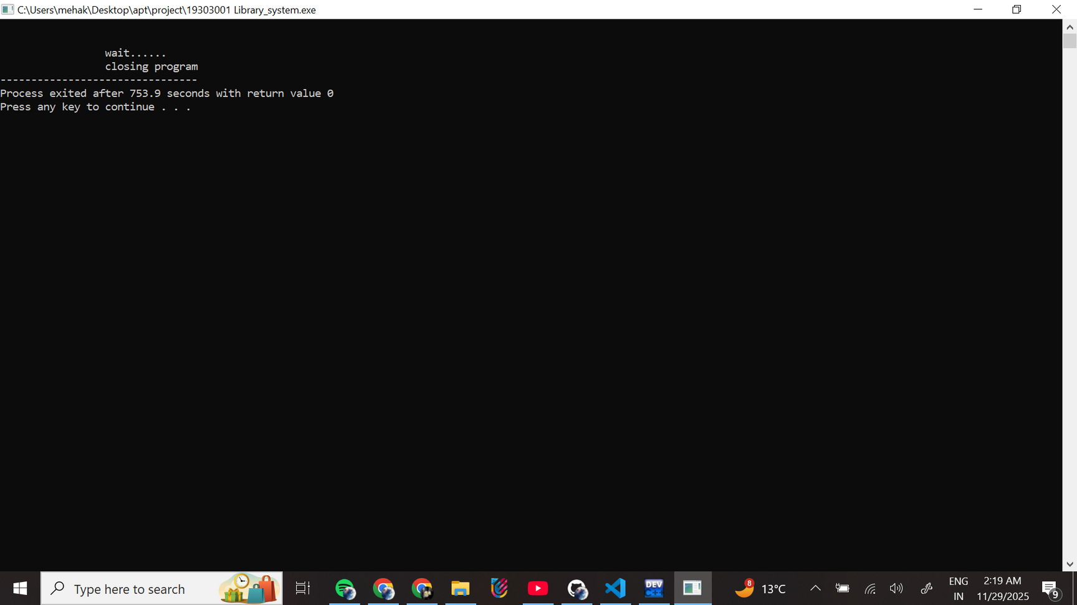
CHOICE 4
CHOICE 6
CHOICE 7
CHOICE 5

Slide 11

C FEATURES USED
Functions
Structures (struct)
File Handling (fopen, fread, fwrite, fseek, remove, rename)
Pointers & File Pointers
String Handling (strcmp, strcpy, scanf)
Loops and Conditional Statements
Menu-driven Program (nested options)
Global Variables
Arrays for storing names, authors, passwords

Slide 12
CONCLUSION
“In this project, we built a simple and user-friendly Library Management System that makes everyday library work faster and more organized. It replaces manual registers with a digital system that can store books, manage users, and handle borrowing, returning, and searching in a more accurate way.
By using C programming and file handling, the system keeps data safe even after closing the program. Admins can easily manage books, and users can quickly find and borrow the books they need. Overall, this project shows how a small software solution can make library operations smoother, reduce errors, and save time for both readers and librarians.
This system may be basic, but it successfully proves how technology can simplify real-life tasks.”

Slide 13
THANK YOU

